Slide 1


Introduction to Tailwind CSS

Slide 2
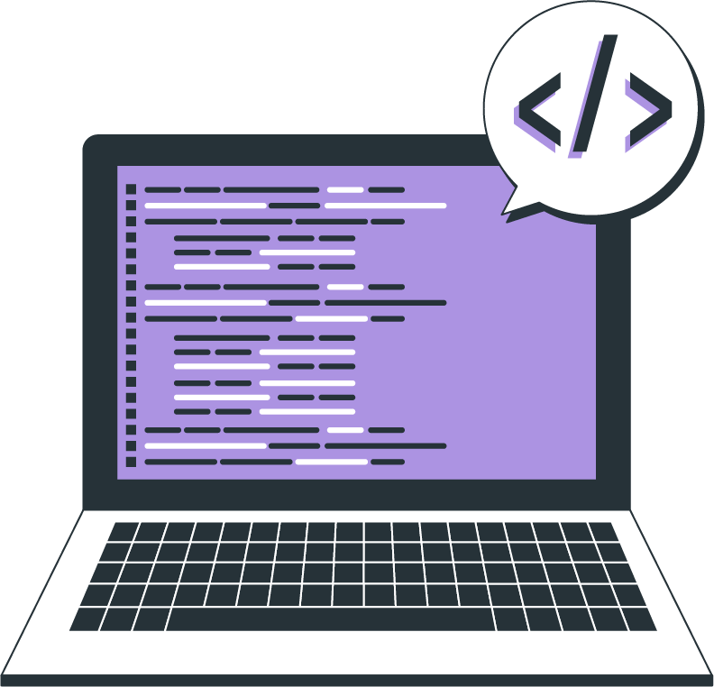
Topics
What is CSS Framework
Why CSS framework over CSS
What is Tailwind CSS
Advantages of Tailwind CSS
Disadvantages of Tailwind CSS
Understanding the utility first approach to CSS
Installing and setting up Tailwind CSS in a project

Slide 3
What is CSS Framework
A CSS framework is a pre-written collection of CSS files that provides a set of pre-built CSS classes and styles that you can use to style your HTML elements. Rather than starting every project from scratch, a CSS framework gives them tools to quickly create a user interface that they repeat and tweak during a project. They also enable the creation of more standards-compliant websites.

Slide 4
Why CSS framework over CSS
Consistency
Efficiency
Responsive design

Slide 5
What is Tailwind CSS
Tailwind is a utility-first CSS framework for rapidly building custom user interfaces. It provides a set of pre-built CSS classes to help you quickly and easily style your HTML elements. It is designed to make building and styling websites faster and more efficient.

Slide 6
Advantages of Tailwind CSS
Faster Development
Consistency
Easy Maintenance
Responsive Design
Customizable

Slide 7
Disadvantages of Tailwind CSS
Learning Curve
Large file size
Overuse of Classes
Limited Flexibility
Limited Browser Support
Accessibility
Maintenance

Slide 8
Understanding the utility first approach to CSS
HTML
CSS
<div class="bg-light-gray p-20px w-500px m-20px">
<h1 class="font-20px arial m-0">Utility-first CSS?</h1>
</div>
.bg-light-gray { background-color: lightgray; }
.p-20px { padding: 20px; }
.w-500px { width: 500px; }
.m-20px { margin: 20px; }
.font-20px { font-size: 20px; }
.arial { font-family: Arial; }
.m-0 { margin: 0; }

Slide 9
THANK YOU

